Slide 1
Real-time static gesture detection using Machine Learning
From: Sandipgiri Goswami
Supervisor : Dr.Kalpdurm Passi

Slide 2
Contents
Background
Objective
Dataset
Hardware Configurations
Software Used
Image Processing
Machine Learning

Slide 3
About Language:
The method of human communication, either spoken or written, consisting of use of words in structured and conventional way.
There are roughly 6,500 spoken languages in the world today.
English as a global language.
With more than 350 million people around the world speaking English as a first language and more than 430 million speaking it as a second language.

Slide 4
About Sign Language
Sign Language is a language which uses to convey a message by hand movements, facial expression and body language to communication.
It is mainly used by deaf and people who can hear but cannot speak.
Sometime family member and relatives must learn sign language to interpreters which enable deaf and wider communities to communicate with each other.
In fact, there are somewhere between 138 and 300 different types of sign language used throughout the world today

Slide 5
Different Sign Language in the Americas
North America | Central America | South America
•American Sign Language •Inuit Sign Language •Quebec Sign Language •Puerto Rican Sign Language | •Costa Rican Sign Language •Guatemalan Sign Language •Honduras Sign Language •Mayan Sign Language •Mexican Sign Language •Nicaraguan Sign Language •Panamanian Sign Language •Salvadorian Sign Language •Tijuana Sign Language | •Argentine Sign Language •Bolivian Sign Language •Brazilian Sign Language •Chilean Sign Language •Colombian Sign Language •Ecaudorian Sign Language •Paraguayan Sign Language •Peruvian Sign Language •Uruaguayan Sign Language •Venezuelan Sign Language

Slide 6
Misunderstandings about Sign Language
Most people who are not disabled think that sign language is just simple a manual representation of the spoken language which is not true.
In fact, our language and sign language of the deaf have little in common.
Sign language has the difficulty of the verbal language but it is self-determining from the alphabets
The best example is British Sign Language and American Sign Language which are meaningless although the facts that disable people from the United States and Britain perfectly understand each other.
Another common misunderstanding about sign language is that it globally understandable which is of course not true. As explained above, the sign language that is used by the deaf in the Unites States and Britain are very not the same

Slide 7
About American Sign Language(ASL)
American Sign Language is implemented from French sign language which was introduced by Thomas Hopins in the United States.
ASL is similar to French sign language; Individuals who speak American Sign Language are able to effectively communicate in French Sign Language.
A variation of American Sign Language also exits. Similarly, to English which is an international language, but it has unique variations between English spoken in England, the United States or Australian, there is separate difference that has changed in sign language.

Slide 8
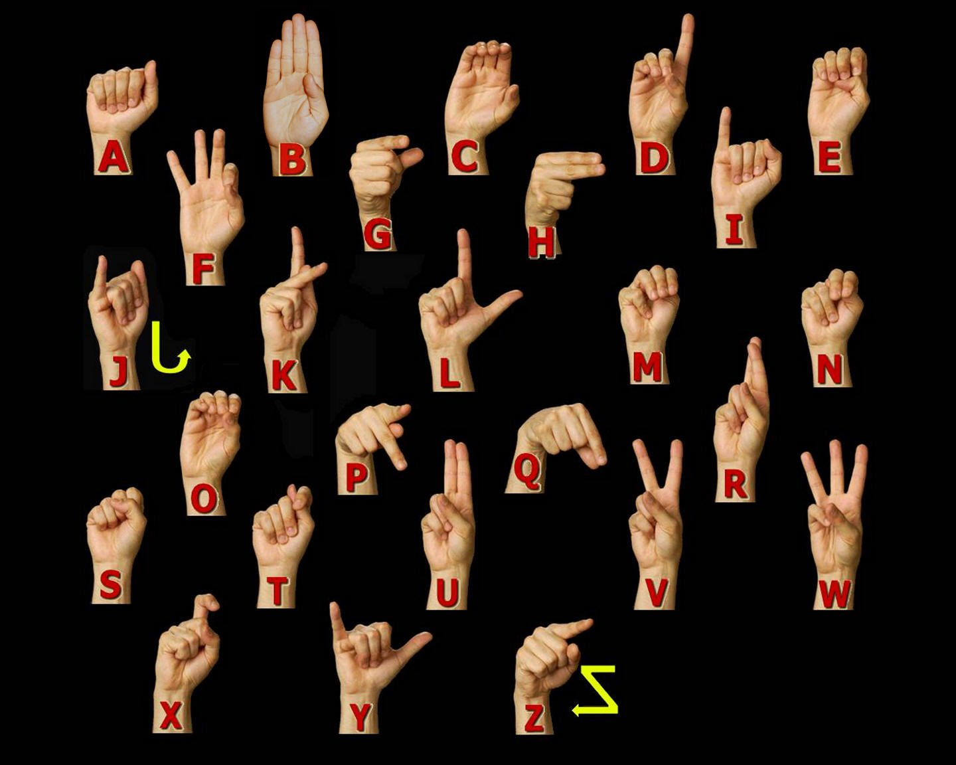
ASL Manual Alphabet

Slide 9
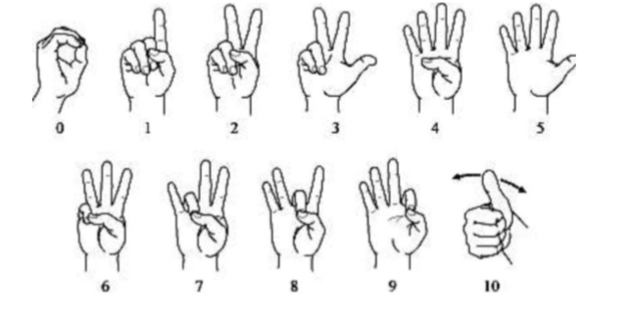
American Sign language numbers

Slide 10
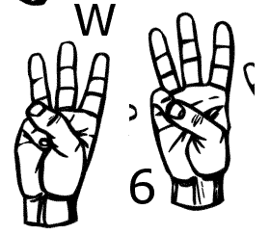
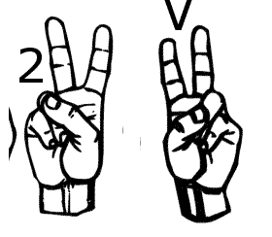
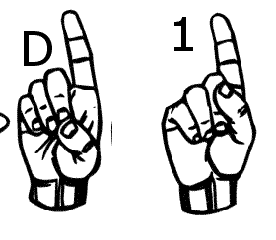
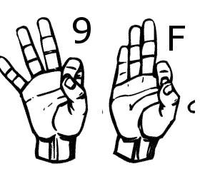
Similar Sign Gesture

Slide 11
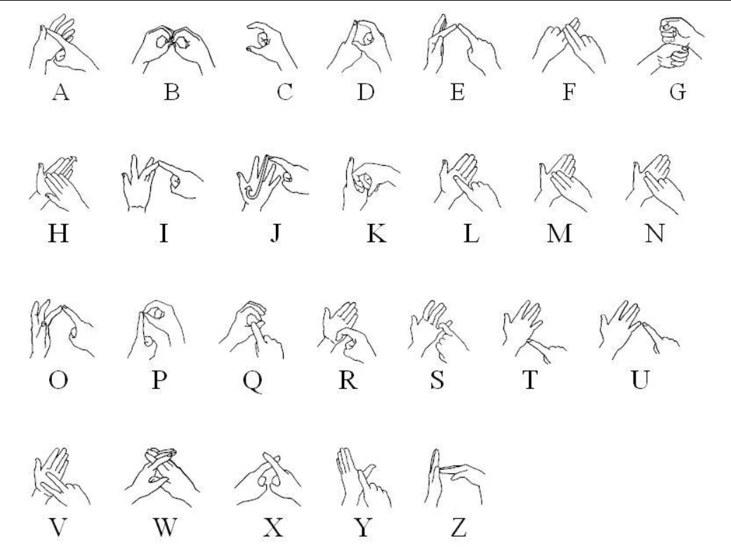
British Sign Language

Slide 12
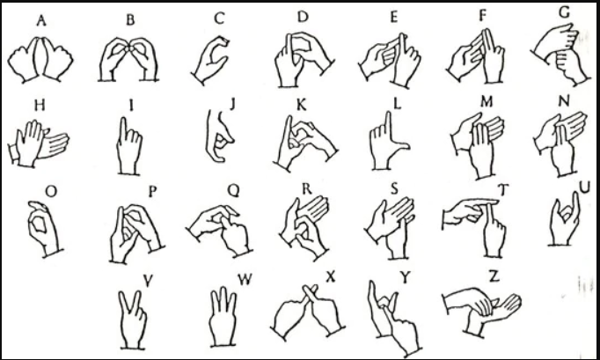
India Sign Language

Slide 13
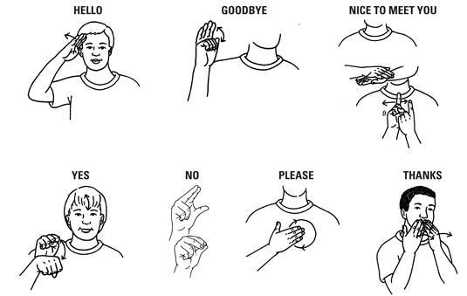
A few words in Sign language

Slide 14
Statistics about sign language use in Canada
American Sign Language | 2,485
Quebec Sign Language | 730

Slide 15
Statics about Knowledge of Sign Languages
American Sign Language | 11,110
Quebec Sign Language | 730

Slide 16
Objective:
My thesis main objective to help the deaf community to increases their self-esteem and IQ level and improve their communication skill. A student who is deaf or has a deaf parent or has a close relative with deaf individual will learn by themselves about sign language alphabets and numbers.
Deaf community will learn their first step toward to American sign language. Although the correct usage of sign gesture plays a very important part in effective communication.
A deaf student also encouraged to establish a connection to the deaf community and to carry their new knowledge and skill beyond the classroom and into the community at large.

Slide 17
Dataset and variables:
I have created my own data set. This dataset was a collection of 36 which contain A to Z alphabet and 0 to 9 numbers digit.
In my dataset consist of A to Z alphabet and 0 to 9 numbers where I have used right hand to capture 1200 images for specific alphabet and numbers.
After that, I implement code which converts flip image to the right to the left-hand image.
The height and width ratios vary significantly but average approximately 50X50 pixel.
The dataset contains over 84,600 images in grayscale color. Additionally, People who want to add their images to this dataset than they can add.

Slide 18






Dataset Sample
S | A | N | D | I | P

Slide 19
Dataset Description and Image property
Property | Description
Alphabets | A to Z
Numbers | 0 to 9
Color | Gray Scale
Dimensions | 50x50
Height | 50 pixels
Width | 50 pixels

Slide 20
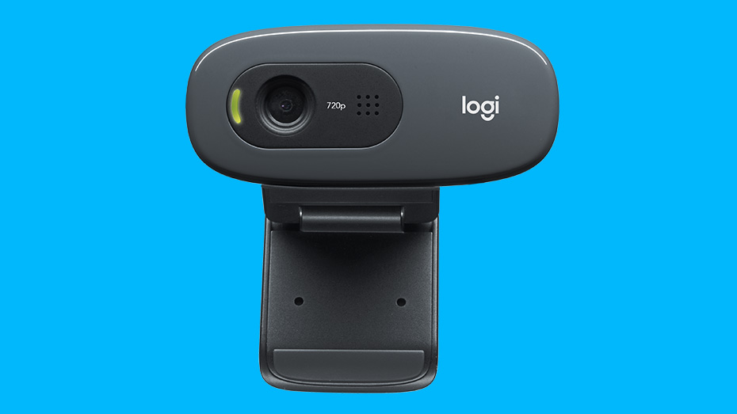
Hardware Configurations
GPU | GeForce GTX 1080 4GB
CPU | Intel(R) Core(TM) i7-8550 CPU @ 2.00GHz
Memory | DIMM 1333MHz 8GB

Slide 21
Software
Keras | 2.04
Tensor flow | 1.1.0
Python | 3.53
Operating System | Window 10
Open CV | 2.0

Slide 22
Software Used
Python: Python is used to simplifying the complex software development process as it is a general-purpose programming language. It is used for developing the complex application like scientific and numeric application, and for both desktop and web applications.
Tensor flow : It was originally created for internal use in Google for a machine learning project, but it was launched as open source in 2015. Tensor flow calculations are expressed as stateful dataflow graphs, which enables efficient support for GPU supported computation. Tensor flow is currently advertised as one of the fastest frameworks for deep learning needs.
Keras : Keras is new software for machine learning, but developed project written in python. It is a high level neural network API. It is built capable of running on top of either Theano or Tensor flow libraries. It is very simple with an emphasis on quick model development. It is very simply extensible.
OpenCV : (Open Source Computer Vision Library) is released under a BSD license and hence it’s free for both academic and commercial use. It has C++, Python and Java interfaces and supports Windows, Linux, Mac OS, iOS and Android. OpenCV was designed for computational efficiency and with a strong focus on real-time applications. Written in optimized C/C++, the library can take advantage of multi-core processing.

Slide 23
Different software library
NumPy :NumPy is a package in Python used for Scientific Computing. NumPy package is used to perform different operations. The ndarray (NumPy Array) is a multidimensional array used to store values of the same datatype.
Matplotlib: Matplotlib is a plotting library for the Python programming language and its numerical mathematics extension NumPy. It provides an object-oriented API for embedding plots into applications using general-purpose GUI toolkits.
Pickle: It is used for serializing and de-serializing a Python object structure. Any object in python can be pickled so that it can be saved on disk. What pickle does is that it “serializes” the object first before writing it to file. Pickling is a way to convert a python object (list, dict, etc.) into a character stream.

Slide 24
Image Processing
A general explanation of computer vision in image processing can be brief in the following steps:
Image capture - Image is captured using a camera or similar device and digitized.
Pre-processing – A captured image is modified to highlight important features such as noise reduction, contrast normalization etc.
Segmentation detection - Selection of region of interest like edges, similar surfaces.
Description – Feature extraction of radiometric, photometric descriptors and so on.
Classification - Some means to categorize the object.
Notes:
A Gaussian filter is a linear filter. It's usually used to blur the image or to reduce noise. ... The Gaussian filter alone will blur edges and reduce contrast. In blurring, we simple blur an image. An image looks more sharp or more detailed if we are able to perceive all the objects and their shapes correctly in it. ... This shape of an object is due to its edges.

Slide 25
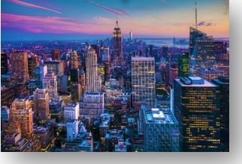
Color Image

Slide 26
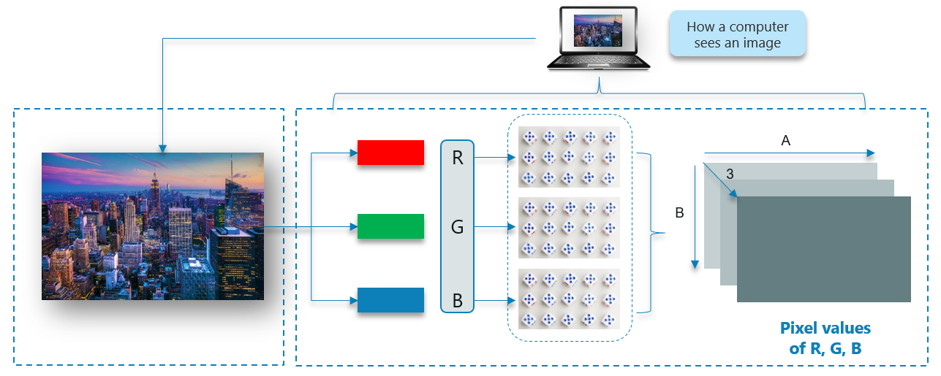
How Does A Computer Read an Image?

Slide 27
Gray Scale image

Slide 28
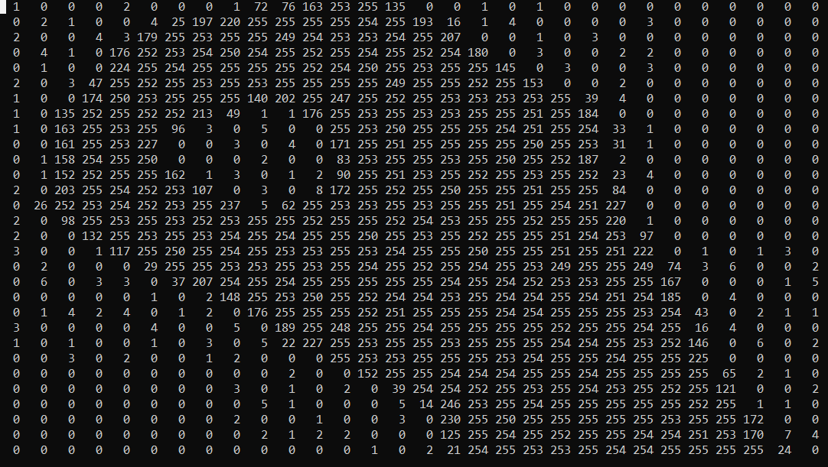
Gray scale image to 2D matrix

Slide 29
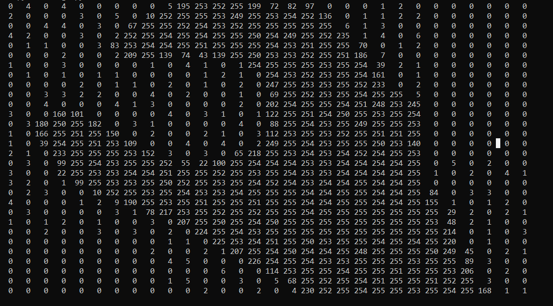
Gray scale image to 2D matrix

Slide 30
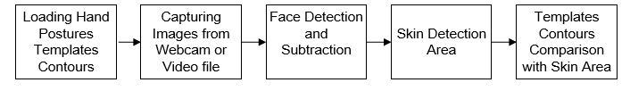
Hand posture detection steps

Slide 31
Machine Learning Approach
There are mainly two different types of machine learning methods:
Unsupervised Learning
Supervised Learning

Slide 32
Unsupervised Learning
In the unsupervised learning method, the model is trained by detecting new data and take out patterns in the data without being instructed on what they are.
The model can learn from data without supervision.
This means that there is no need for input data to be explained.
Required smaller time and resource's to deploy.
The mainstream of unsupervised learning procedures belongs to a group called clustering algorithms.

Slide 33
Unsupervised learning models methods:
K-means -clustering model
Self Organizing Maps (SOMs)
Principal Component Analysis (PCA) - dimensionality reduction

Slide 34
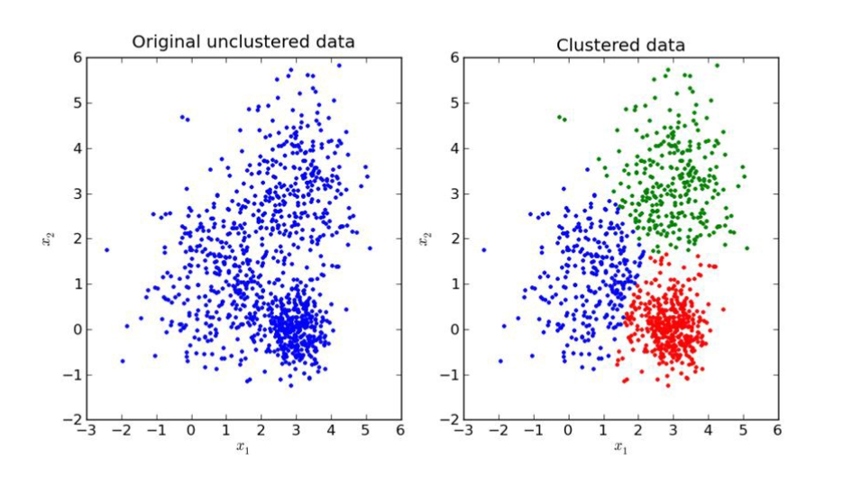
Unsupervised Learning Image

Slide 35
Supervised Learning
The supervised learning method is more commonly used.
This method needs training data with a specific format. Each instance must have assigned label.
Supervised learning problems can be further grouped into regression and classification problems.
Classification: A classification problem is when the output variable is a category, such as “red” or “blue” or “disease” and “no disease”.
Regression: A regression problem is when the output variable is a real value, such as “dollars” or “weight”.
The training process of supervised learning as follows
First, the training data are fed into the model to produce estimates of output.
This estimate is compared to the assigned label of the training data in order to evaluate model error.
Based on this error the learning algorithm alters model’s parameters in order to reduce it.

Slide 36
Supervised learning models methods:
Some popular examples of supervised machine learning algorithms are:
Linear regression for regression problems.
Random forest for classification and regression problems.
Support vector machines for classification problems.

Slide 37
Structure of Machine Learning Algorithm
Dataset description
Model
Cost function
Optimization technique

Slide 38
Neural Network Architecture
Single layer feed forward network.
Learning in feed-forward networks use for supervised learning, in which pairs of input and output values are supplies into the network for many loops, so that the network trained the interconnection between the input and output.
Multilayer Feed Forward Network
Backpropagation is a method used in artificial neural networks to calculate a gradient that is needed in the calculation of the weights to be used in the network
Self Organizing Map(Unsupervised Learning)

Slide 39
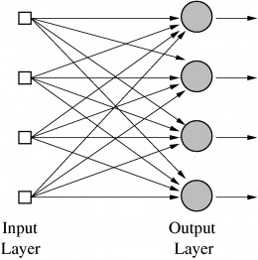
Single Layer feed forward network

Slide 40
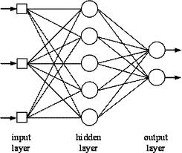
Multilayer feed forward network

Slide 41
Multilayer feed forward network
Input layer-It contains those units (Artificial neurons) which get contribution from the outside world on which system will learn, perceive about or generally process.
Output layer — It contains units that react to the data about how it’s learned any task.
Hidden layer — These layers are in between input and output layers. The main objective of the hidden layer is to transfer the input into something that output unit can use and analyse.
Neural networks are fully connected when every node in a hidden layer is fully connected to every node in its previous layer(input) and to the next layer (output) layer.

Slide 42
Thank you

